Slide 1
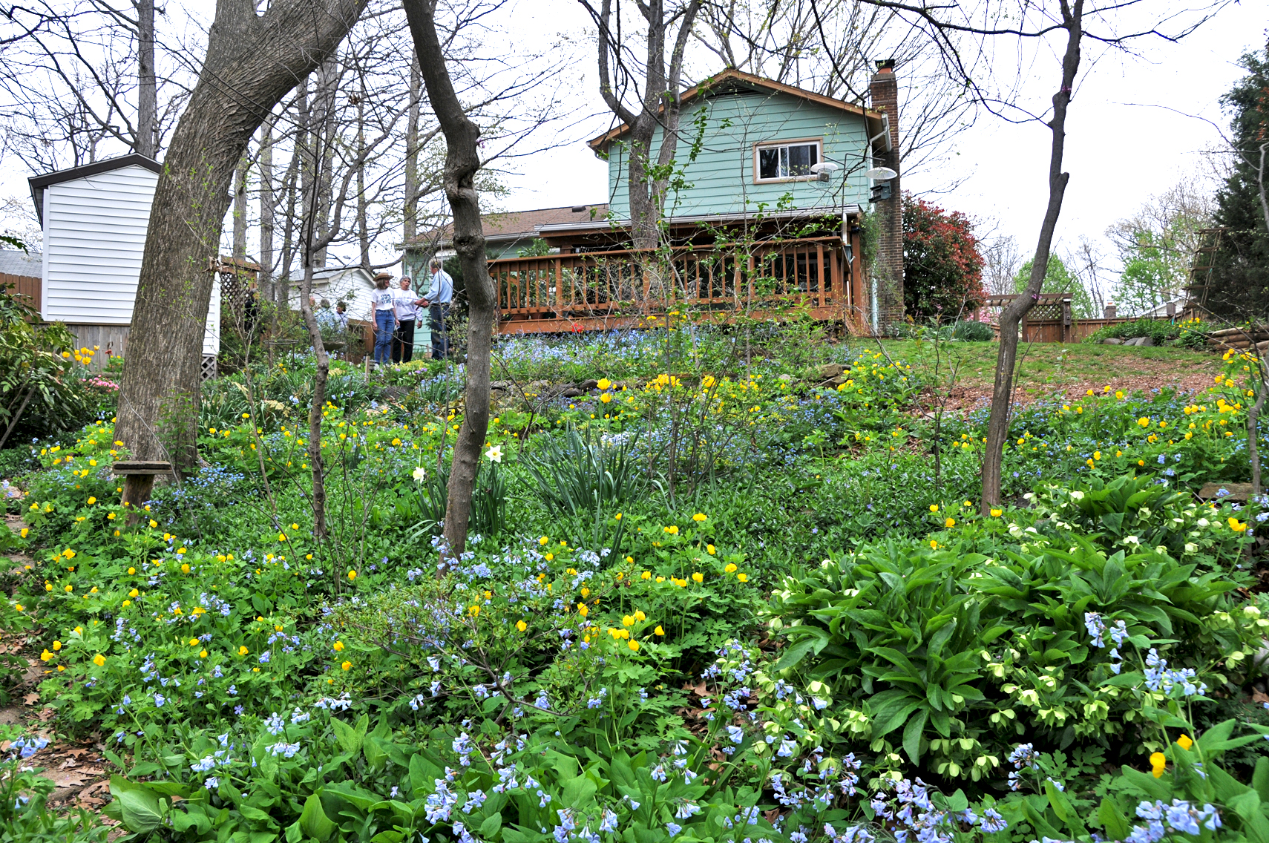
One Yard at a Time
PEC Sustainable Landscaping Workshop
Prince William Conservation Alliance
August 29, 2015

Slide 2
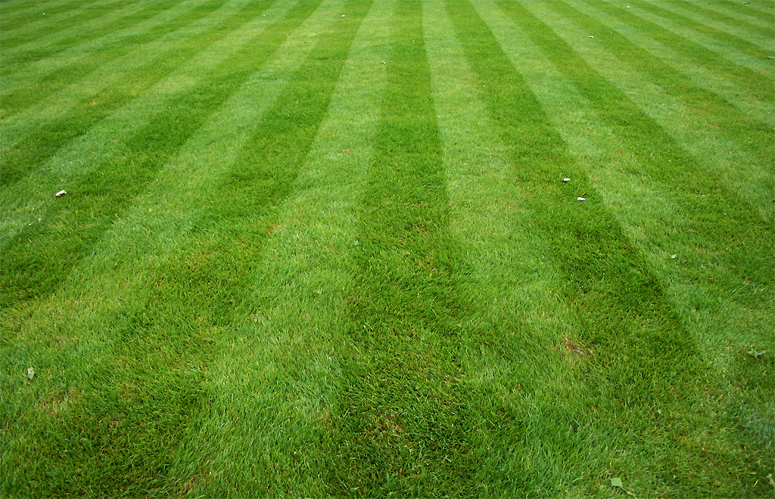
Lawn in the United States: 40.5 million acres
Money spent on lawn care: $30 billion
Water use for residential irrigation: >7 billion gal/day
Amount of fertilizers used: 3 million tons/year
Amount of pesticides used: >30 thousand tons/year
Source: Duke University, Statistically Speaking: Lawns by the Numbers; 2008
Notes:
Recognize the impacts from all that lawn, at a personal, community, national and global scale.
Habitat lost to wildlife … Single most toxic thing inside or outside your home.
Peanut butter is an $800 million industry. $17 billion spent in 2013 for Mother's Day
In FY 2000 the federal government spent $631.5 million combating invasive species, with almost 90 percent of the total spent by USDA.

Slide 3
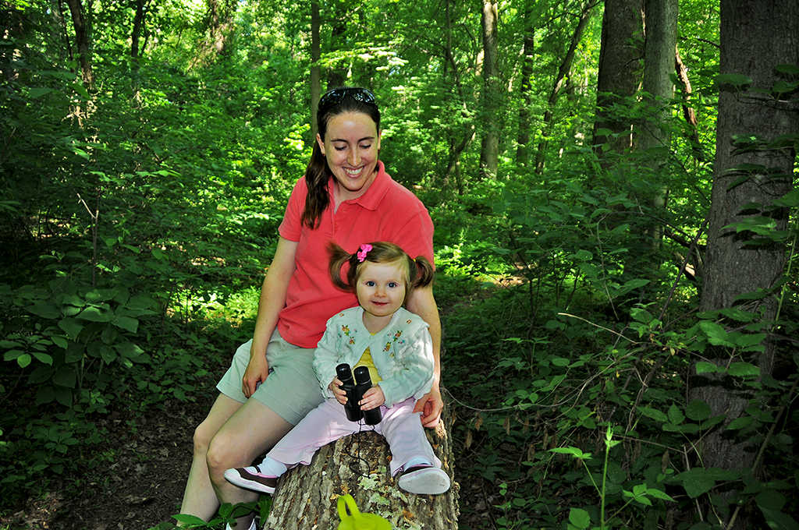
Reduce stormwater, improve soil and water quality, improve people’s health and well being, reduce noise pollution, reduce vehicle accidents, improve property values, create jobs, increase retail sales, store carbon and reduce emissions, reduce crime, increase energy efficiency, protect canopy coverage, create habitat, etc.
Featherstone NWR
Notes:
Recognize the significant benefits of urban forests.
Benefits of New York’s implementation of a forest protection strategy instead of building a new water treatment plant will save the city $6 billion.
Street trees in New York City intercept 890 million gallons of stormwater annually: 1,525 gallons per tree on average, with a total value of over $35 million
each year.

Slide 4
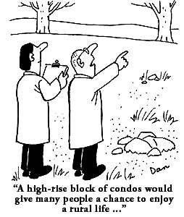
Big Things Often Have Small Beginnings
Urbanization and development is the single biggest factor in loss of forestland acreage in Virginia.
Source: VA Dept. of Forestry
A high-rise block of condos
would give many people a chance to enjoy a rural life…
Notes:
Since 2001, 484,965 acres of forested land has been lost to land use changes; 64% of this acreage were cleared for urban development; 30% to agricultural uses; and the balance to other land uses.

Slide 5
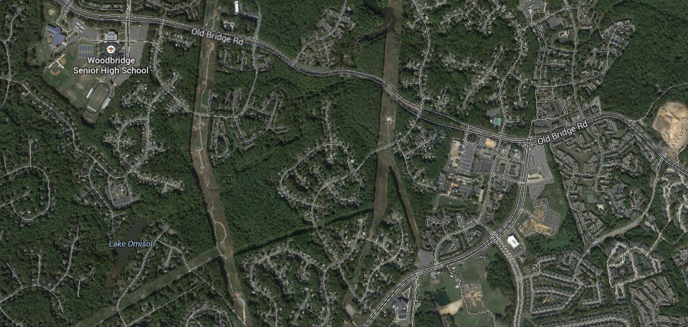
No parcel is too small to make a difference
Every little bit helps. It’s amazing how much you can do
^{when you} choose to give a little bit of that ^{natural habitat back.}
^{--Roxanne Paul}

Slide 6
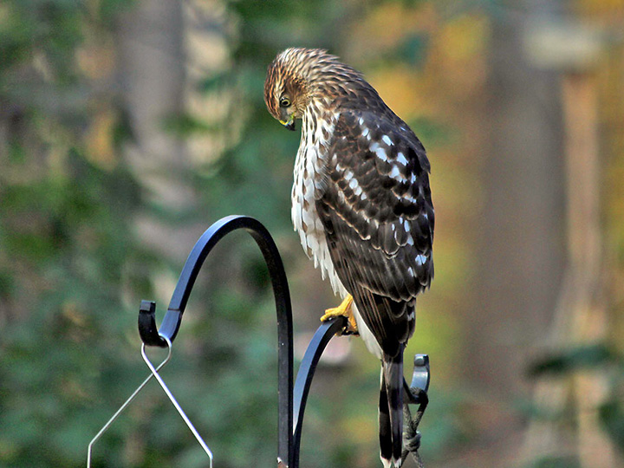
Backyard Bird List: 57 Species
Sharp-shinned Hawk
Red-shouldered Hawk
Red-tailed Hawk
Cooper’s Hawk
Mourning Dove
Great Horned Owl
Barred Owl
Chimney Swift
Ruby-throated Hummingbird
Red-bellied Woodpecker Red-headed Woodpecker Yellow-bellied Sapsucker Downy Woodpecker
Hairy Woodpecker
Northern Flicker
Pileated Woodpecker
Blue Jay
Tree Swallow
American Crow
Fish Crow
Carolina Chickadee
Tufted Titmouse
White-breasted Nuthatch
Red-breasted Nuthatch
Brown Creeper
Carolina Wren
House Wren
Ruby-crowned Kinglet
Eastern Bluebird
Wood Thrush
Hermit Thrush
American Robin
Gray Catbird
Northern Mockingbird
European Starling
Yellow Warbler
Yellow-rump Warbler
Ovenbird
Eastern Towhee
American Tree Sparrow
Field Sparrow
Song Sparrow
White-throated Sparrow White-crowned Sparrow Dark-eyed Junco
Rose-breasted Grosbeak
Northern Cardinal
Red-winged Blackbird
Rusty Blackbird
Brown-headed Cowbird
Common Grackle
Purple Finch
House Finch
Pine Siskin
American Goldfinch
House Sparrow

Slide 7
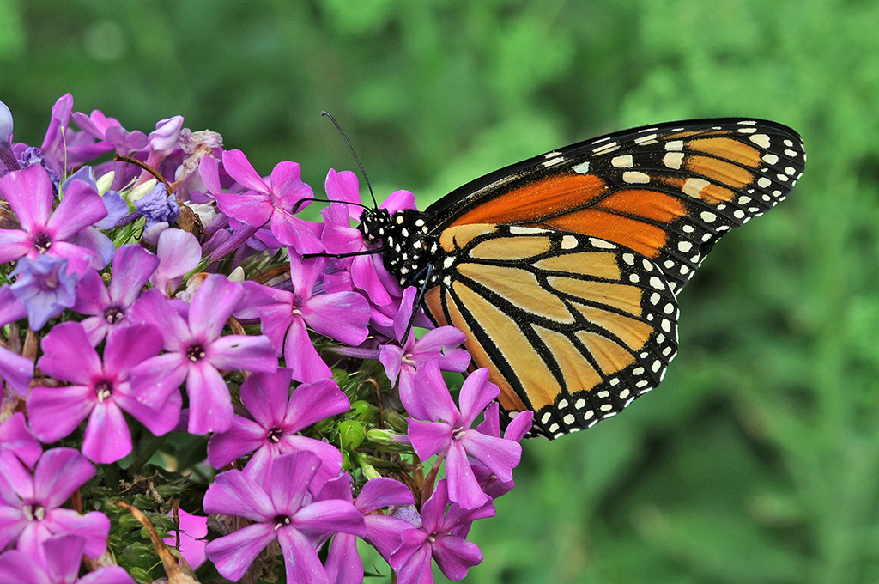
Black Swallowtail
Eastern Tiger Swallowtail
Spicebush Swallowtail
Cabbage White
Clouded Sulphur
Orange Sulphur
Falcate Orangetip
Red-banded Hairstreak
Gray Hairstreak
Eastern Tailed-Blue
Spring Azure
Summer Azure
Variegated Fritillary
Great Spangled Fritillary
Pearl Crescent
Mourning Cloak
American Lady
Painted Lady
Question Mark
Red Admiral
Red-spotted Purple
Viceroy
Monarch
Silver-spotted Skipper
Juvenal’s Duskywing
Horace’s Duskywing
Clouded Skipper
Least Skipper
Sachem
Peck’s Skipper
Delaware Skipper
Hobomok Skipper
Zabulon Skipper
Dun Skipper
Backyard Butterfly List: 35 Species

Slide 8
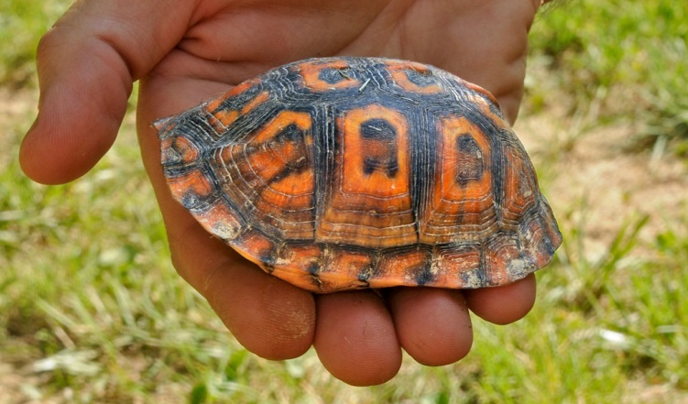
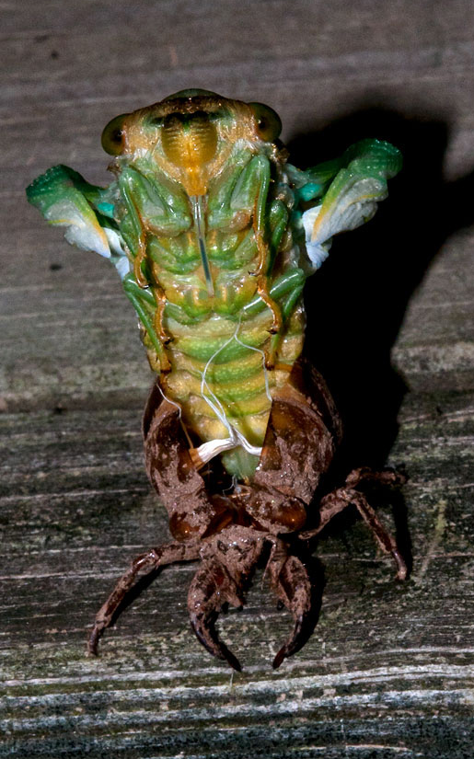
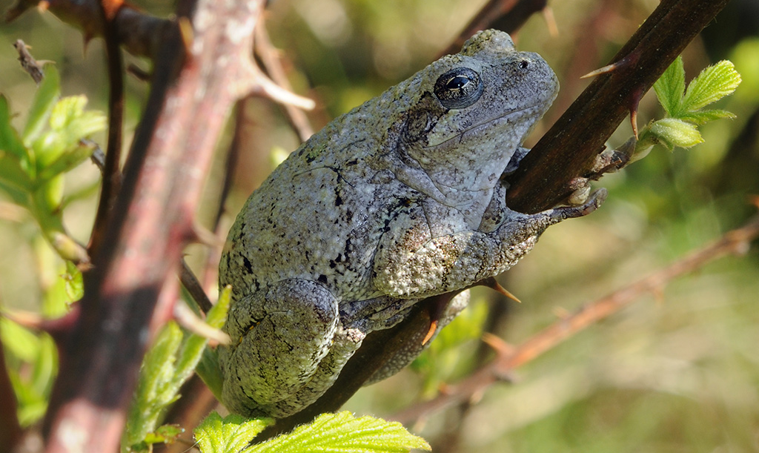
Plus Herps, Mammals, Insects
Eastern Box Turtle
Cope’s Gray Treefrog
Cicada

Slide 9
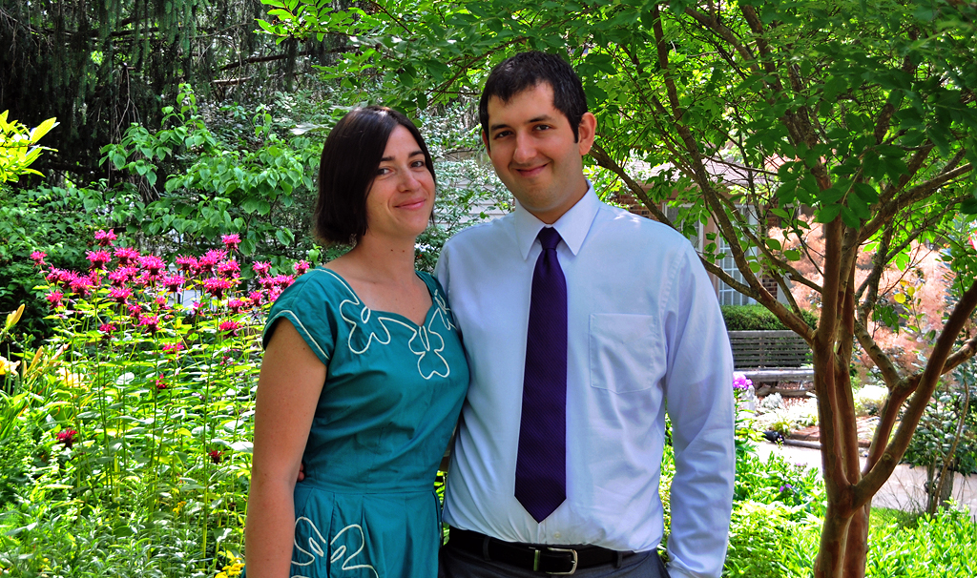
The suburbs are the new frontier. This is going to be the place where all these living things find refuge. -Rick Darke

Slide 10
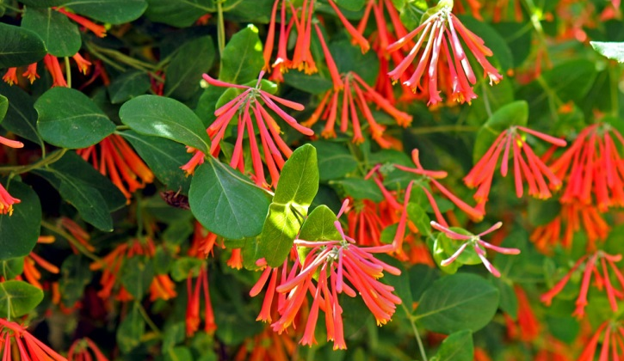
Conservation Within Our Reach
Incorporating native plants into our personal landscapes is the single best way each of us can help enhance and restore the habitat so critically needed by wildlife, while increasing our own enjoyment and pleasure in all things wild and beautiful.
--Lou Verner, Virginia Dept. of Game & Inland Fisheries
Photo: Julie Flanagan
Trumpet Honeysuckle

Slide 11
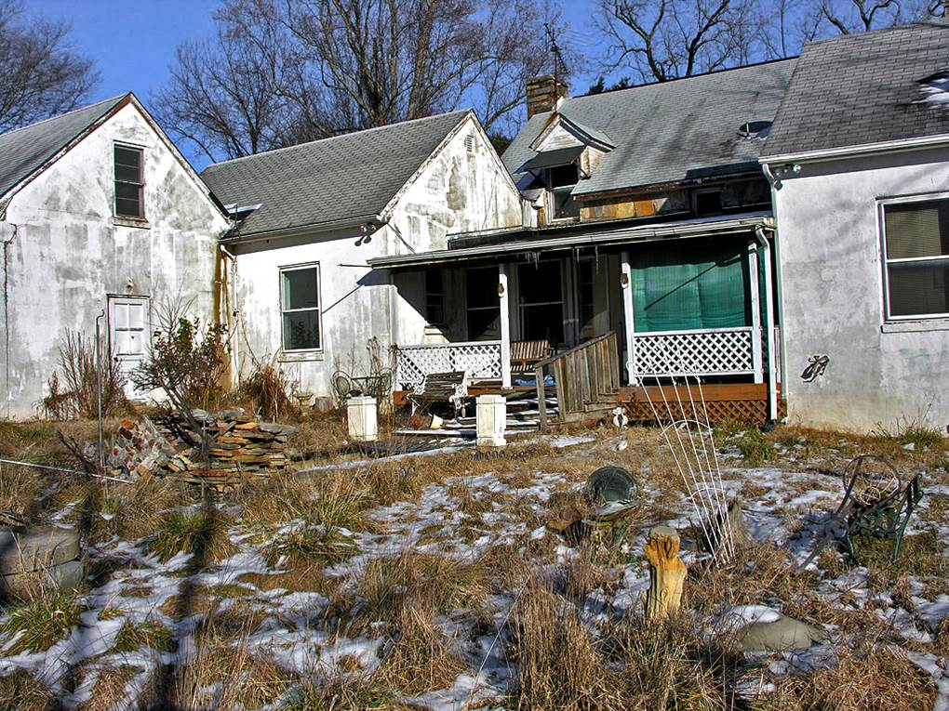

Slide 12
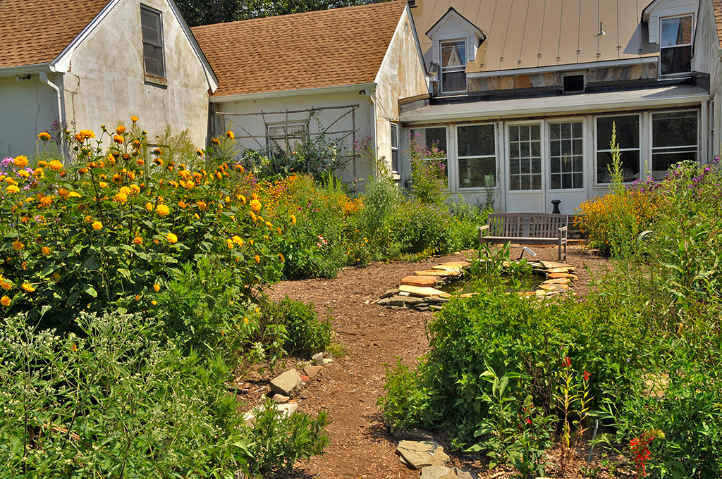

Slide 13
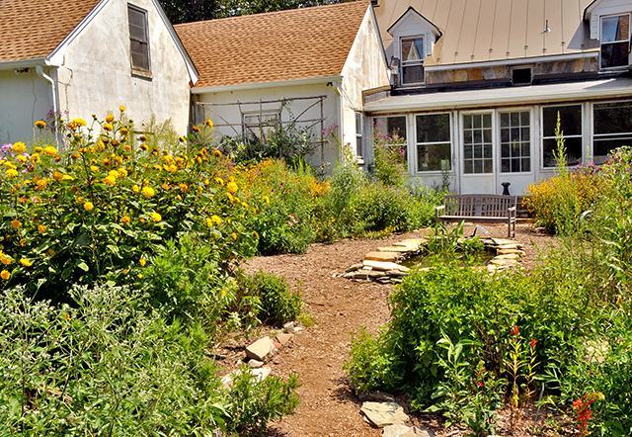
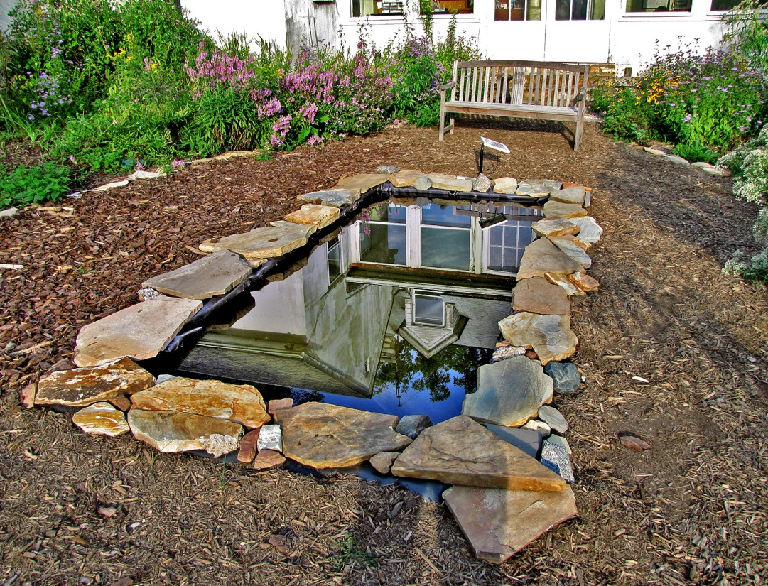
Improve property values, reduce stormwater, create wildlife habitat

Slide 14
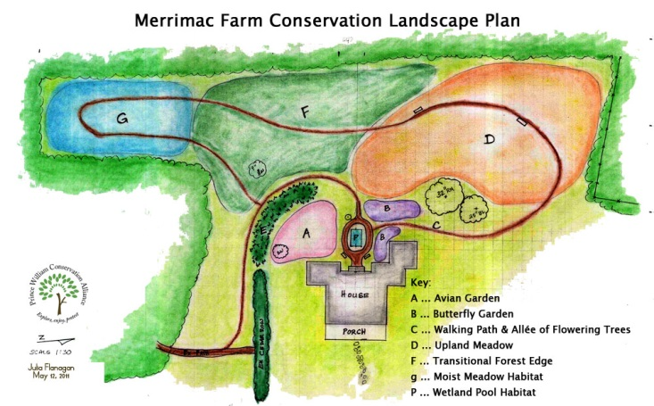
Notes:
Start from beginning… volunteers can see the project from start to finish and be confident they can duplicate at home. They are seeing cause and effects.

Slide 15
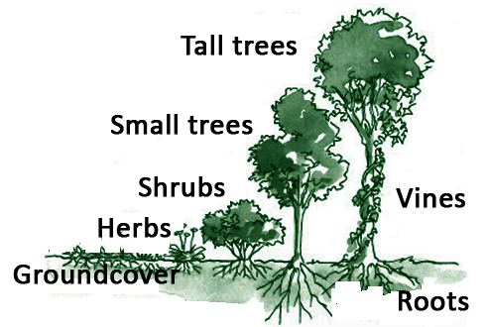
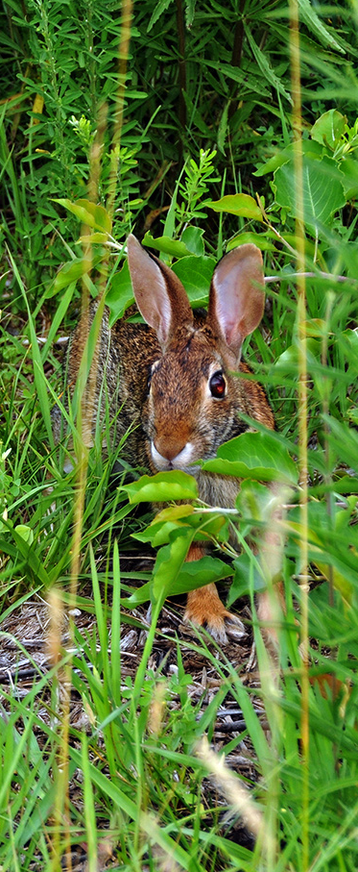
Consider your habitat mosiac
Gardening is civil and social, but it wants the vigor and freedom of the forest and the outlaw. --Henry David Thoreau
Notes:
The arrangement of plants into different layers, including ground (grasses/forbes), understory (shrubs and young trees), and canopy (mature trees), is related to the successional stage of the habitat or plant community. Wildlife diversity usually is associated with the number and density of vertical layers present.

Slide 16
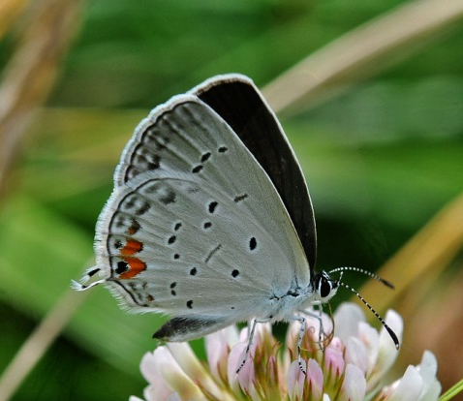
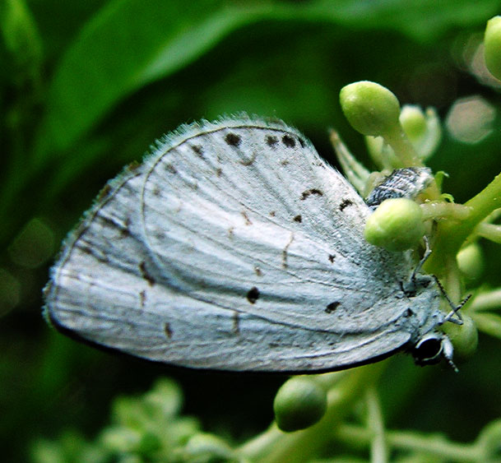
Wildlife diversity is usually associated
with the number and density of
vertical layers.
Eastern Tail Blue
Azure

Slide 17
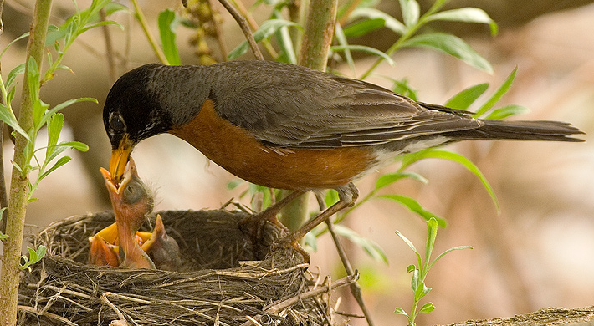
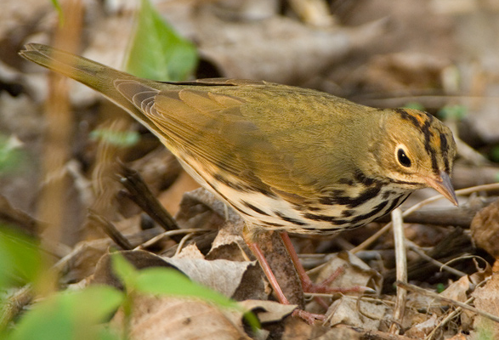
Vertical structure provides nesting and foraging sites, cover and travel routes
American Robin
Ovenbird
Notes:
particularly important in determining which bird species might be present. Birds choose habitat vertically as well as horizontally, and individual species are associated with specific layers of vegetation. For example, wood thrushes generally nest from 5 to 15 feet above the ground and are rare if vegetation is not present in this layer. Many species require multiple layers of vegetation. Worm-eating warblers, for example, nest on the ground but forage for insects in foliage, on bark, and on the forest floor. A multiple-layered forest provides essential nesting and foraging sites for many types of birds.
By providing cover and travel routes, a forest with a well-developed vertical structure also benefits other types of forest wildlife, such as small mammals. Gray squirrels and white-footed mice, for example, use the many branches present in a well-developed understory for traveling and escaping from predators.

Slide 18
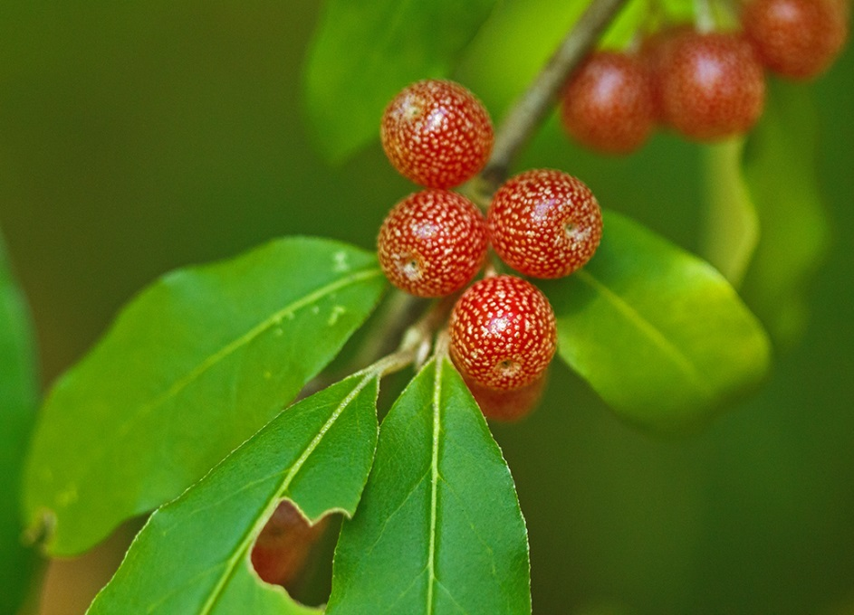
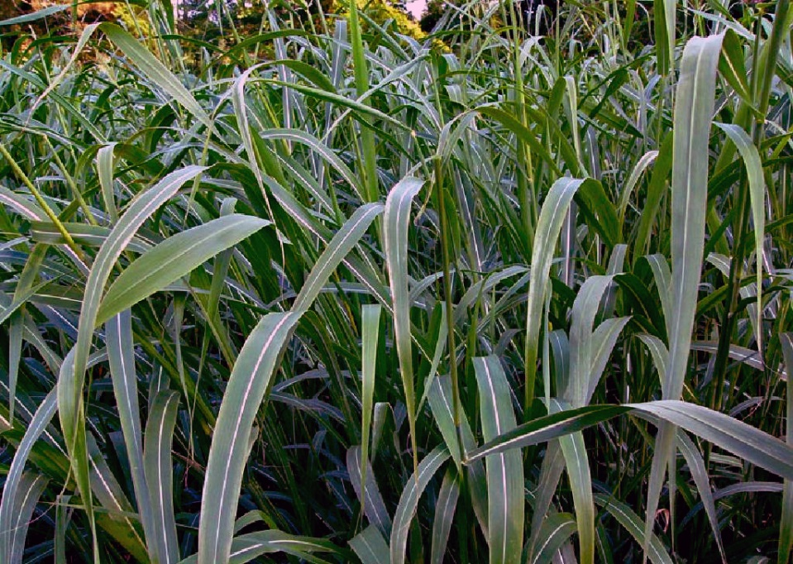
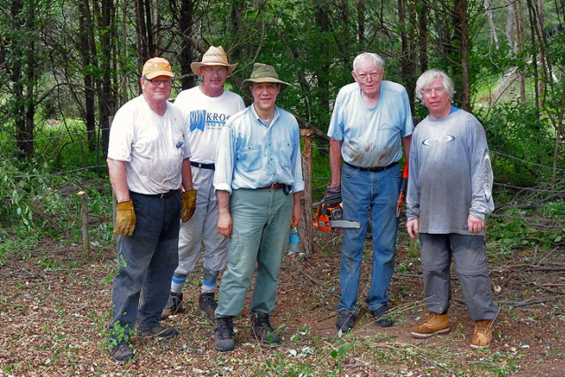
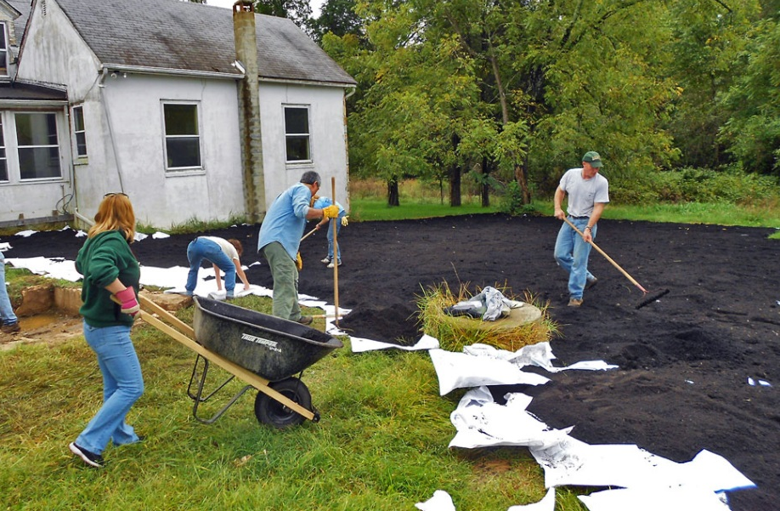
BioBullies
Autumn Olive
Johnson Grass
Notes:
People learn which plants are invasive and how to get rid of them.
PWC Public Works
Johnson grass is one of the 10 most noxious weeds in the world. It reproduces quickly, and its seeds can remain viable for 20 years.
Autumn olive was planted in game lands for wildlife habitat, windbreaks and restoring deforested and degraded lands. Its aggressive growth helps it native plant species, creating dense shade and interfering with nutrient cycling. Seeds do not provide proper nutrition for birds. Attempts to remove the shrub by cutting and/or burning create even more autumn olive.
Replace with Blackhaw Viburnum prunifolium, Black Chokeberry Photinia melanocarpa, Dogwoods Cornus sericea, C. amomum, C. racemosa
Northern Arrowwood - Viburnum dentatum, Serviceberry Amelanchier arborea, Winterberry Ilex verticillata

Slide 19
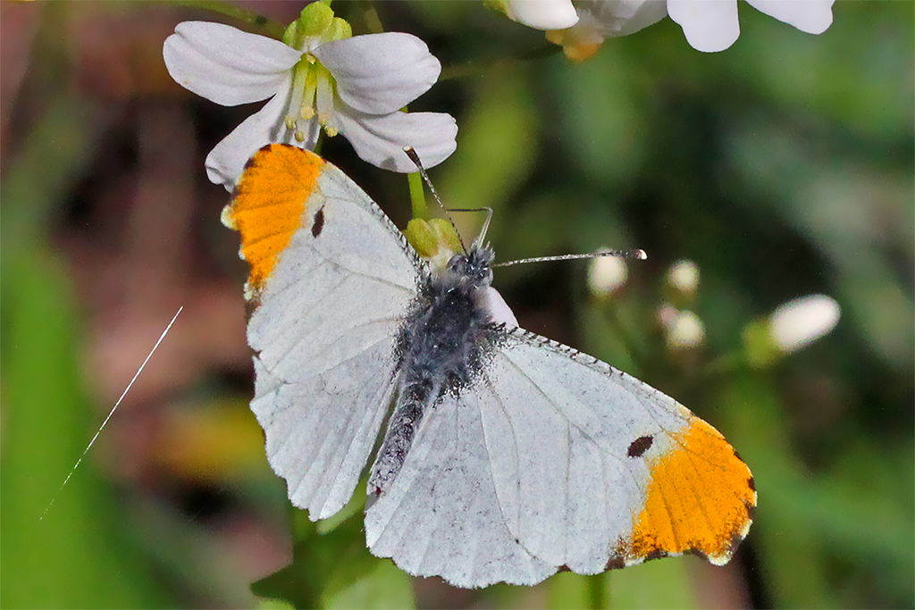
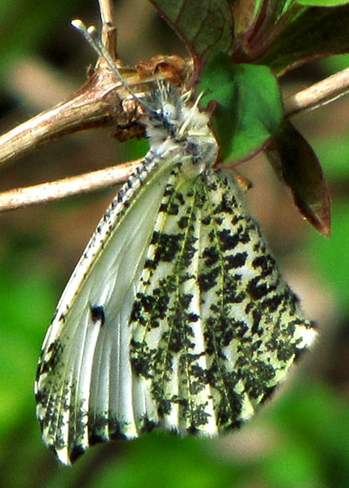
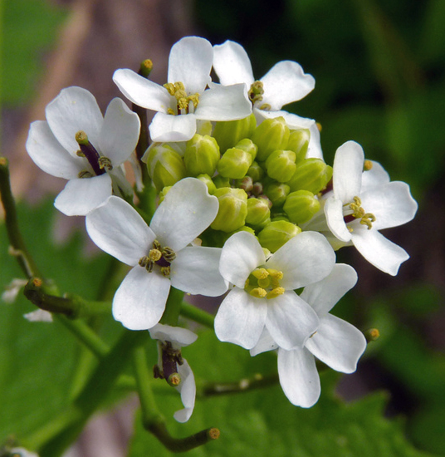
Falcate Orangetip, Anthocharis midea
Nonnative
Garlic Mustard
Notes:
Male wings are falcate and tipped with orange. Lives in low zone… One flight.
Garlic mustard…
The most widely referenced paper (Pimental et al. 2005) on this issue reports that invasive species cost the United States more than $120 billion in damages every year.
In 2011 alone, the Department of the Interior will spend $100 million on invasive species prevention, early detection and rapid response, control and management, research, outreach, international cooperation and habitat restoration.

Slide 20
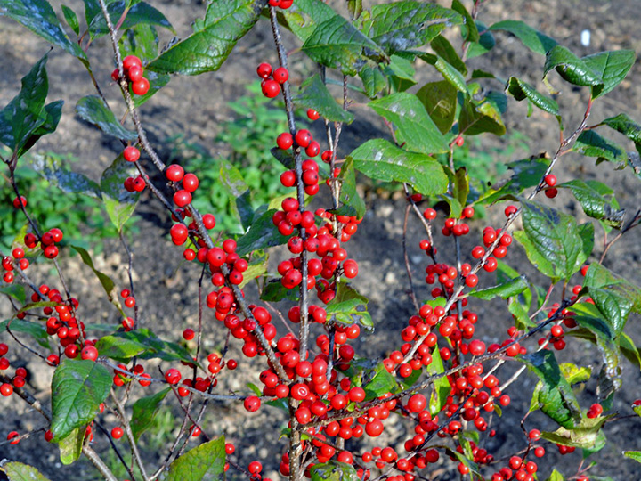
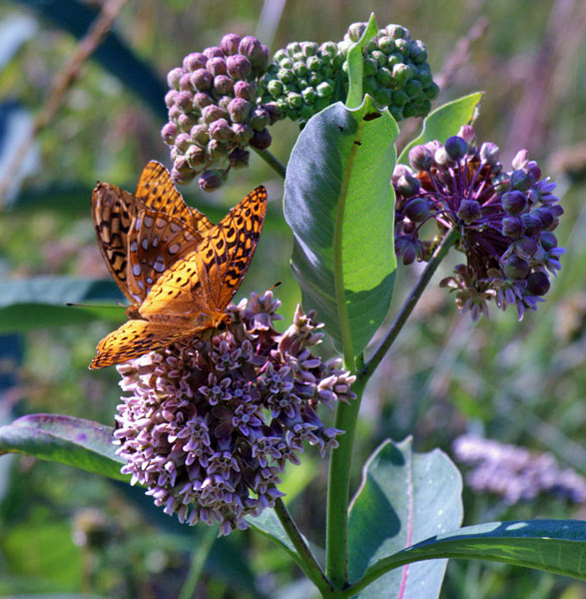
Native insects need native plants to survive.
Native birds and mammals need native insects (as well as native plants) to survive.
No native insects, no higher forms of life.

Slide 21
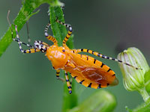
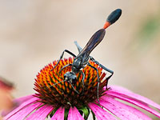
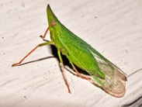
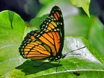
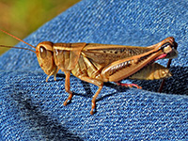
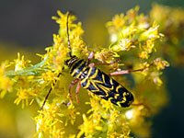
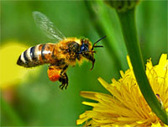
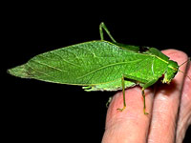
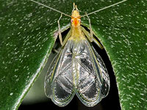
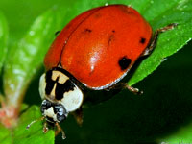
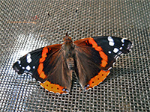
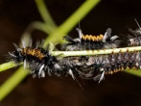
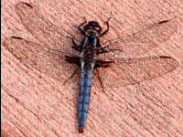
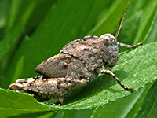
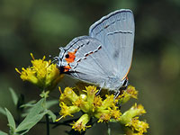
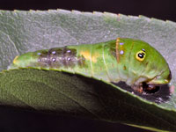
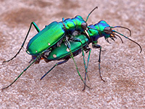
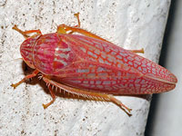
Bugs make the world go round
Notes:
Insects are mostly food
most common animals on our planet
sole food source for many amphibians, reptiles, birds, and mammals
primary or secondary decomposers.
keep pest populations (insects or weeds) at a tolerable level
Pollinators – flowers, fruit, and vegetables

Slide 22
One brood of Carolina Chickadees eats 6,000 caterpillars
Virginia Tiger Moth
Tussock Moth
Silvery Checkerspot
Tiger Swallowtail
Notes:
Carolina Chickadees bring insects, mostly caterpillars, at an average rate of 1 every 3 minutes! Do the math and it adds up to over 6000 caterpillars to raise one brood!

Slide 23
Eight-spotted Forester
Notes:
Edge, where your lawn meets the woods.

Slide 24
Black Swallowtail from caterpillar to butterfly
Golden Alexanders, Zizia aurea
Notes:
Keep in mind, planning for all life stages.

Slide 25
Sleepy Orange
Wild Senna, Senna marilandica
Notes:
Want to be mindful to plant habitat for the things you’re trying to attract.

Slide 26
Monarch Caterpillar
Butterfly weed, Asclepias tuberosa
Swamp Milkweed, Asclepias incarnata
Notes:
Due to weather events,
More than 400 of the over 1,300 species [one-third of the] currently protected under the Endangered Species Act, and more than 180 candidate species for listing are considered to be at risk at least partly due to displacement by, competition with, and predation by invasive species.

Slide 27
Tiger Swallowtails Tulip poplar, Liriodendron tulipifera
Notes:
That’s where we come in… easy to see connections. How to tell it works.

Slide 28
Pipevine Swallowtail on Purple Coneflower

Slide 29
Great-spangled Fritillary
Butterfly weed, Asclepias tuberosa
Canadian White Violet, Viola canadensis

Slide 30
Zebra Swallowtail
Butterfly weed, Asclepias tuberosa
Paw paw tree, Asimina triloba

Slide 31
Feather-legged fly, Trichopoda pennipes
Notes:
Beneficial insect that makes it poss
help control garden pests such as gypsy moths, cabbage loopers, Japanese beetles, armyworms, cutworms, sawflies, codling moths, peach twig borers, pink bollworms, tent caterpillars, squash bugs and many more.ible for us to enjoy naturally healthy gardens without the use of pesticides.

Slide 32
Six-spotted Tiger Beetle, Cicindela sexguttata
Predators that eat pest insects, from crickets and grasshoppers to fleas and gnats. In turn, they are food for birds, dragonflies, robber flies, lizards, salamanders, frogs and other small animals.
Notes:
Adults spend winter in burrows and emerge the following spring. Adult females emerge in spring, but do not mate until early May.
The entire life cycle takes 2-4 years or more, a long life for an insect! Their long lives make these beetles valuable for assessing the environmental quality of an area. Because the adults and larvae live in the same habitats for multiple years, they are very susceptible to environmental changes or stresses. The presence of tiger beetles, especially the larvae, in an area is often a sign of good, stable habitat.
They are fast, agile flyers, and are able to catch insects in the air.
Two-year life cycle. Four stages - complete metamorphosis. The first is the egg stage. The female lays eggs in individual holes in the ground during June or early July. The egg hatches and the second stage, known as the larval stage, begins. The larva resembles a caterpillar, but with two unique characteristics. The first is the two sickle-shaped jaws protruding from its abnormally large head, which it uses to catch prey. The other is a hooked hump on its back, which prevents it from being pulled out of the ground. The entirety of the larval stage happens underground. It then reaches the third stage, the pupa a year later. The pupa begins to make its way out of the ground by digging toward the surface diagonally. The adult form of the beetle emerges within a month. The beetle is sexually mature in the spring, mates, and dies during the summer months.

Slide 33
Autumn Meadowhawk, Sympetrum vicinum
Needham’s Skimmer
Notes:
For these reasons, planting projects IN ADDITION to protect existing urban forests and other natural areas.
Merrimac Farm WMA is in the Cedar Run Watershed, impaired waterway.
Add structure and increase native plant diversity
Slow the flow of stormwater
Create high-diversity habitat that is easy to access and always open
Create a meaningful volunteer stewardship opportunity
Demonstrate how everyone can do their part to protect urban forests, clean water resources wildlife habitat while Northern Virginia continues to grow

Slide 34
Familiar Bluet, Enallagma civile

Slide 35
Gardens are for the birds…

Slide 36
Hermit Thrush
Coopers Hawk
Eastern Bluebird

Slide 37
Year Round Habitat
Beautyberry, Callicarpa americana
Winterberry, Ilex verticillata
Notes:
Beautyberry - important food source for many species of birds including bobwhite quails, mockingbirds, robins, towhees, and brown thrashers. Animals that eat the 40 species of songbirds, and are favorites of cardinals, robins, mockingbirds, purple finches, eastern towhees, and especially northern bobwhite. The fruit is also eaten by raccoon, opossum, and gray fox.
Winterberry – low in fat content, eaten later in winter by songbirds, winter waterfowl, and game birds. Frequent songbird consumers include eastern bluebirds, hermit and wood thrushes, American robins, catbirds, northern mockingbirds, brown thrashers, cedar waxwings, and white-tailed sparrows.

Slide 38
Places to hide and reproduce

Slide 39
Plenty of Food for Adults & Young
Macrosiagon limbata
Mating pair of Luna Moths
Notes:
Adults on flowers of goatweed (Capraria), elderberry (Sambucus), thoroughwort (Eupatorium), beebalm (Monarda), goldenrod (Solidago)
The Ripophorids are parastoids of other insects, often solitary bees and wasps. Eggs are laid on flowers that are visited by host insects. The larva hatches on the flower and waits for a suitable host. The Ripiphorid larva attaches to a host and rides to the nest. The Ripiphorid will enter a larva of the host and wait until the host larva is fully developed, then exit the larva and consume it from the outside.

Slide 40
Water for Wildlife
Pickerel Frog
Ebony Jewelwing
Tufted Titmouse
Five-lined Skink
Rough Green Snake

Slide 41
Discover a refuge in your own backyard
Chickadees
Tufted Titmice
Carolina Wrens
Bluebirds

Slide 42
He who plants a tree
Plants a hope.
--Lucy Larcom

